Slide 1
Using Shot Charts to Track NBA Offense
CB Garrett, James Hyman, and Cameron Mitchell
Notes:
CB

Slide 2
1.
Data Collection
Data Updated as of 12/1/21
Notes:
Cam

Slide 3
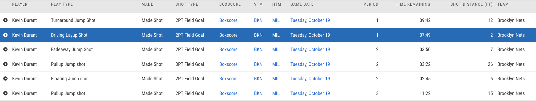
Data Collection
Used nba.com/stats API
Used it to pull every shot taken from 2017-18 to present
Took 1 season at a time, then joined them together
Notes:
Cam

Slide 4
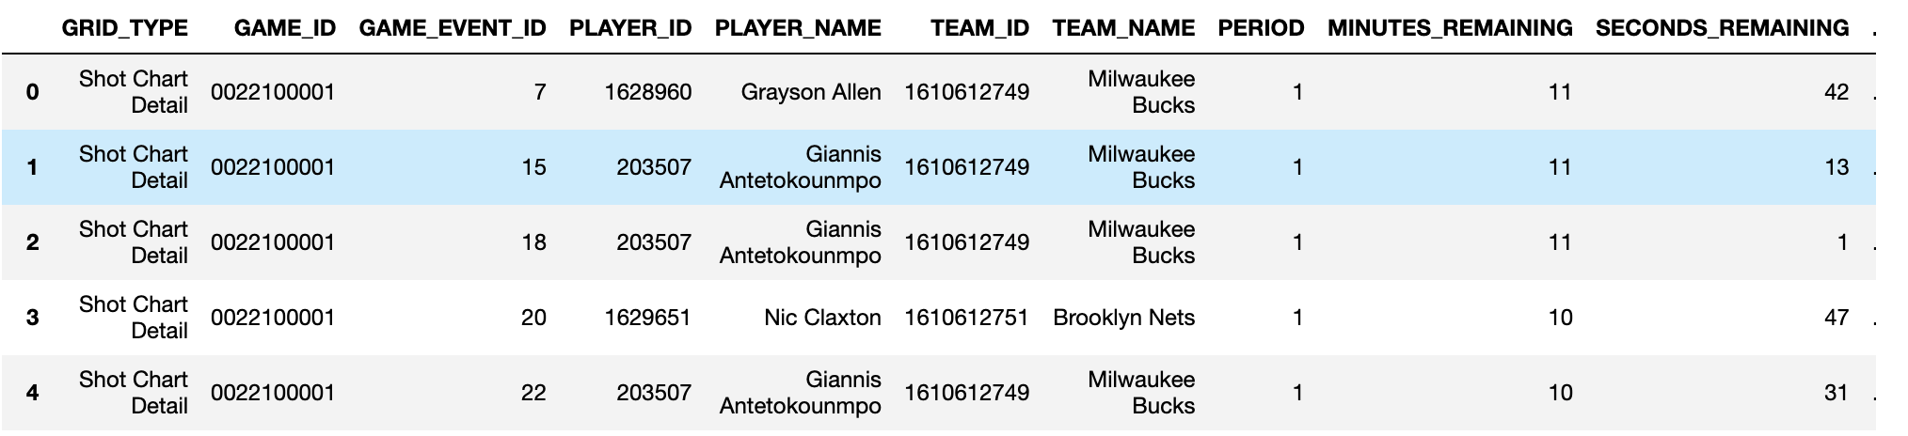
Data Collection
Also includes X-Y coordinates
Notes:
Cam

Slide 5
2.
Data Cleaning/Transformation
Notes:
Cam

Slide 6
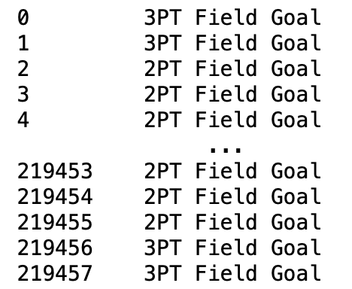
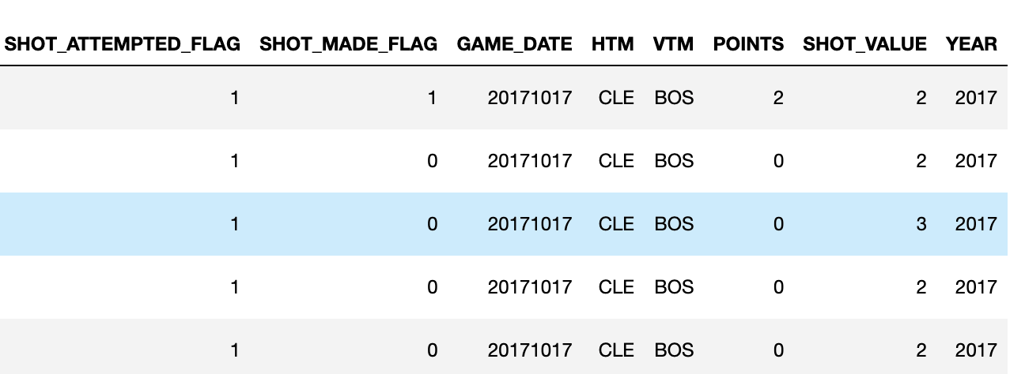
Data Cleaning/Transformation
Transformed data to add point values to each shot as well as shot value
Created year column from game date
Added if each shot was taken by a team that made the playoffs
Notes:
Cam

Slide 7
3.
Data Analysis
Notes:
CB

Slide 8
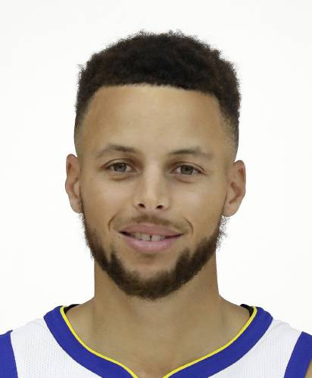
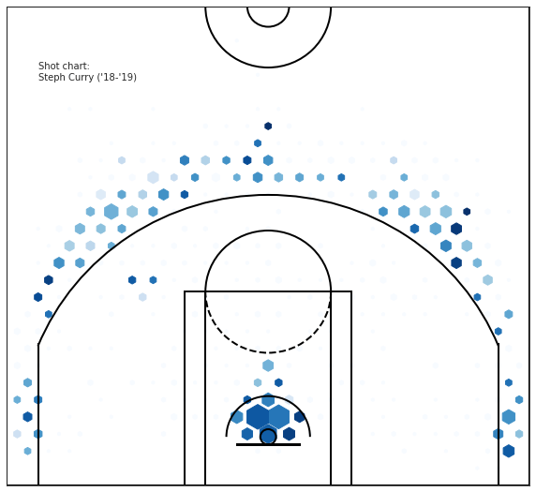
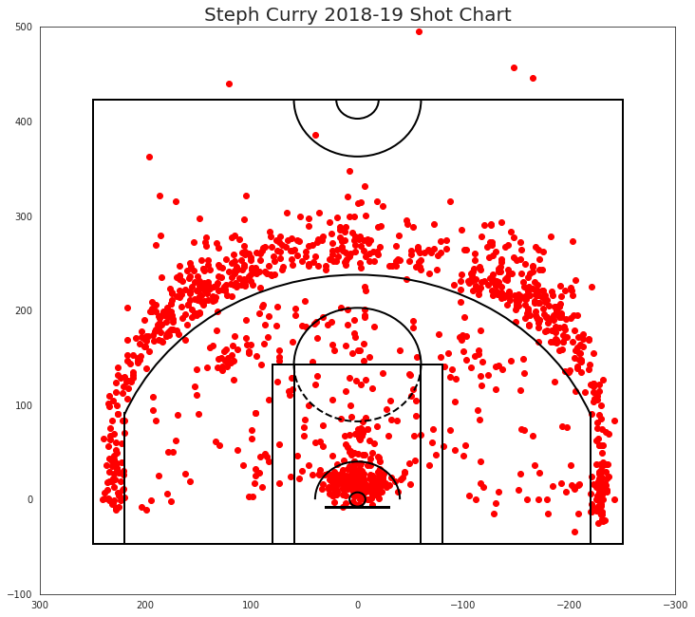
The Trendsetter
Notes:
CB

Slide 9
Year by Year Trends
Season | Field Goal % | Points per shot | % of shots are 3’s | Shot Distance
2017-18 | 45.87 | 1.040 | 33.64 | 13.22
2018-19 | 46.03 | 1.043 | 34.38 | 13.06
2019-20 | 45.87 | 1.049 | 37.06 | 13.20
2020-21 | 46.48 | 1.070 | 38.87 | 13.50
2021-22 | 46.23 | 1.067 | 39.46 | 13.70
Notes:
CB

Slide 10
Efficiency by Shot Distance
Distance | Field Goal % | Points per shot | Shot Distance
Less than 8 feet | 58.0 | 1.16 | 2.17
8-16 feet | 41.7 | 0.83 | 11.4
16-24 feet | 40.3 | 0.81 | 18.4
24+ feet | 36.1 | 1.08 | 25.0
Backcourt | 2.6 | 0.08 | 54.2
Notes:
James

Slide 11
Efficiency by Shot Location
Location | Field Goal % | Points per shot | Shot Distance
Restricted Area | 63.4 | 1.26 | 1.2
Paint (Non-RA) | 40.7 | 0.81 | 7.6
Mid-Range | 40.6 | 0.81 | 16.07
Left Corner 3 | 38.9 | 1.17 | 22.8
Right Corner 3 | 38.7 | 1.16 | 25.6
Above the Break 3 | 35.3 | 1.06 | 25.6
Back Court | 2.1 | 0.06 | 55.4
Notes:
James

Slide 12
Playoffs v. Non-Playoffs
Playoff | Shot Distance | Points per shot | Shooting Percentage | Shot-Value
No(0) | 13.135 | 1.038 | 0.456 | 2.355
Yes(1) | 13.337 | 1.060 | 0.463 | 2.366
Notes:
James

Slide 13
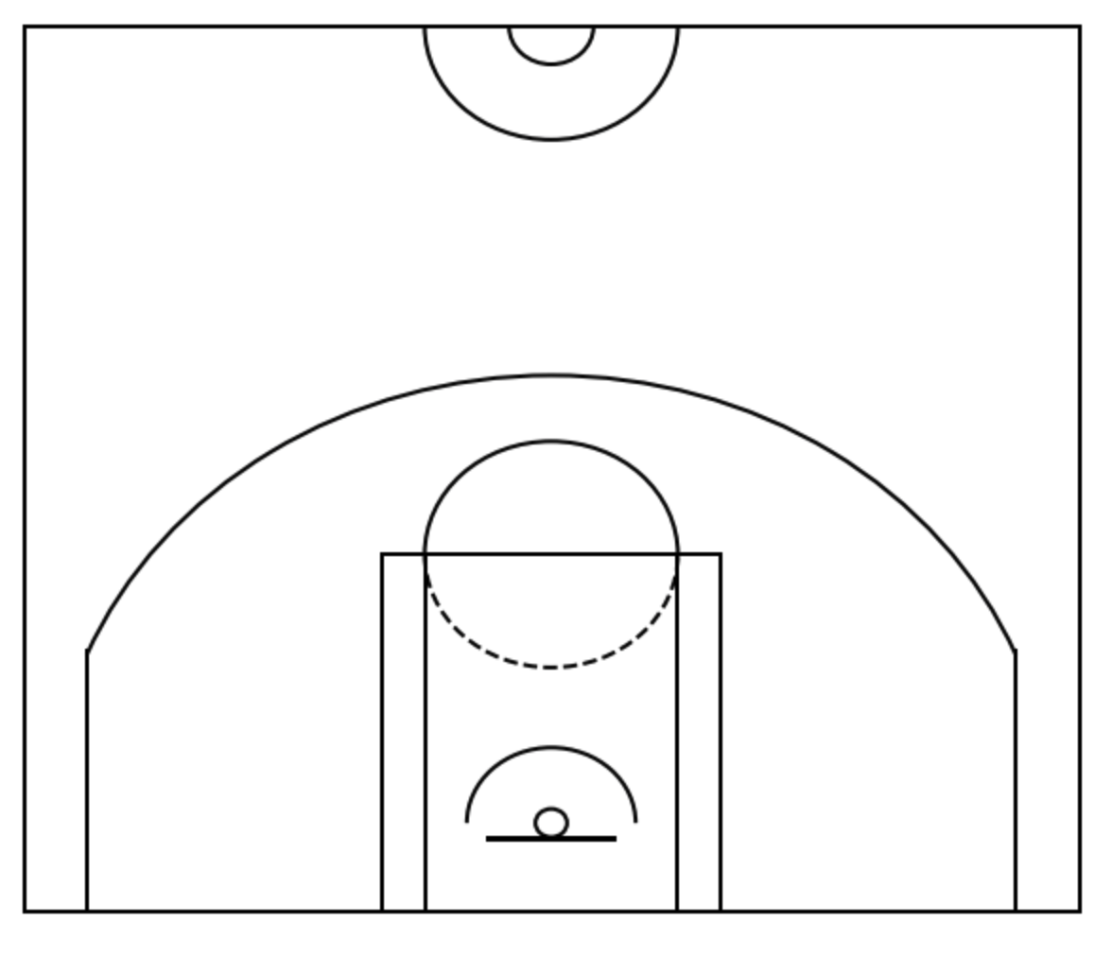
Data Visualization
First needed to create court
Used a variety of different methods to make shot plots based on number of shots looking at
Notes:
CB

Slide 14

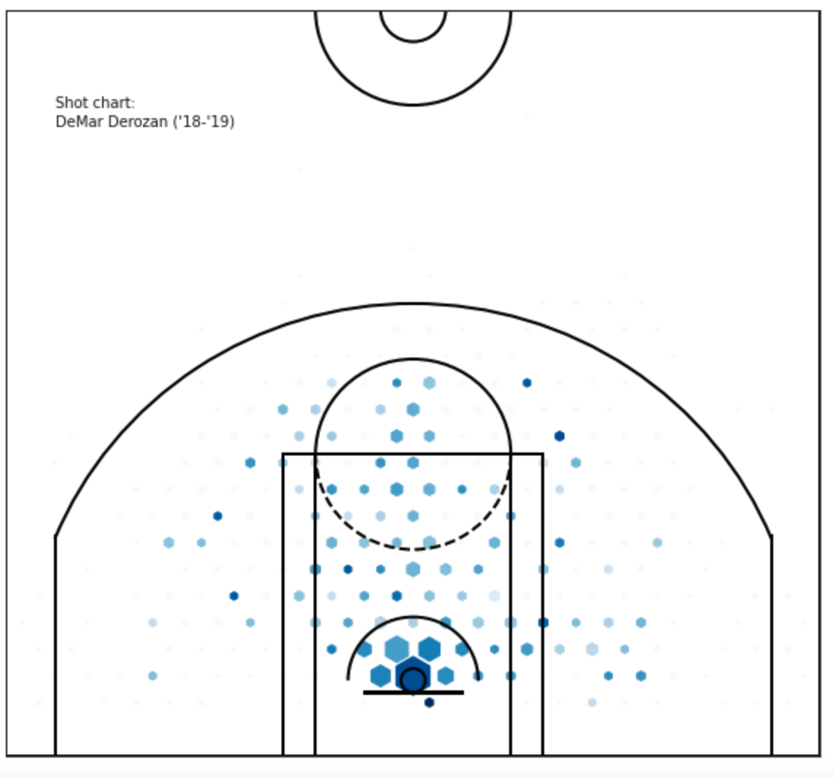
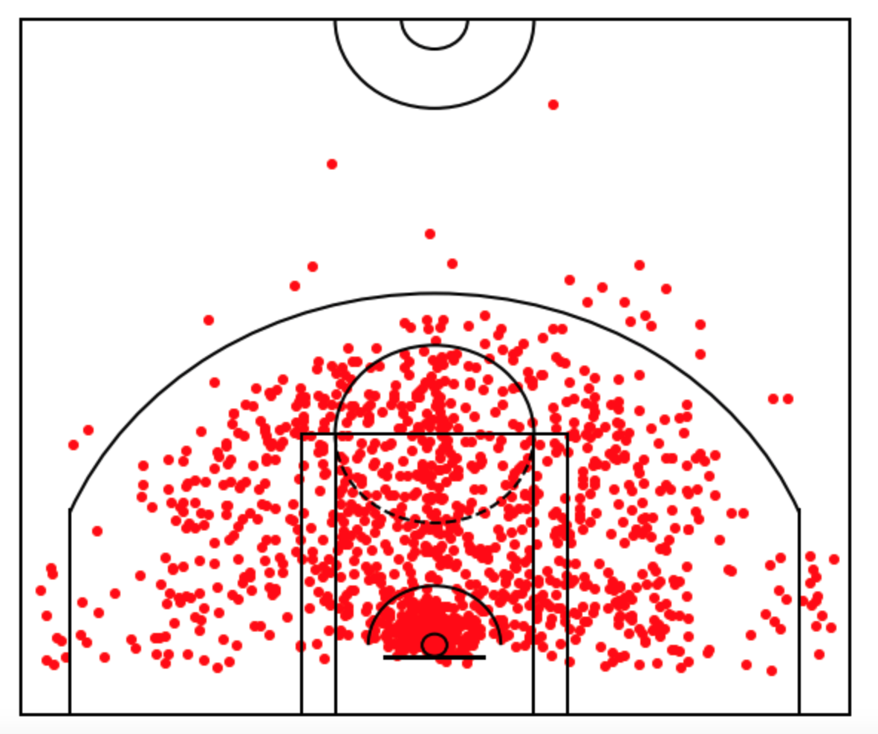
Data Visualization
Notes:
CB

Slide 15
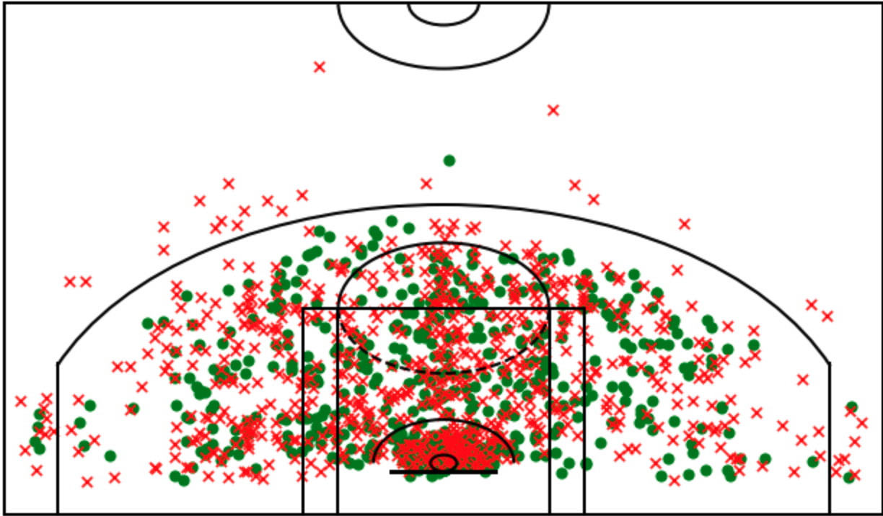
The Rule Breaker
Notes:
CB

Slide 16
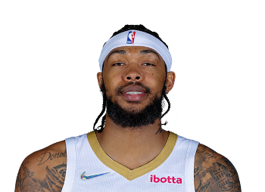
Modern Basketball
Notes:
James

Slide 17
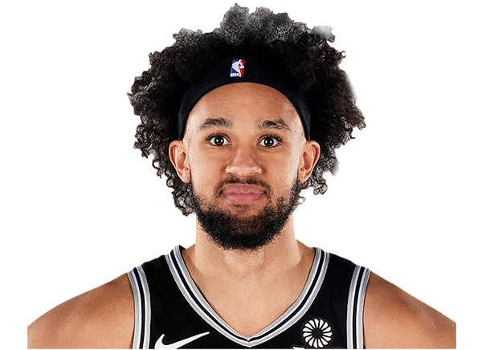
Modern Basketball pt. 2
Notes:
James

Slide 18
Questions?
Notes:
James

